Slide 1
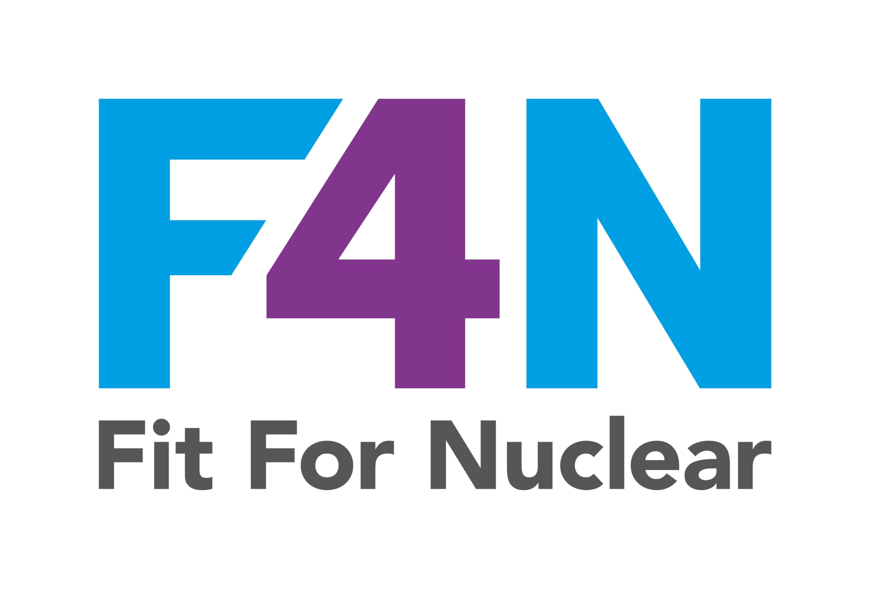

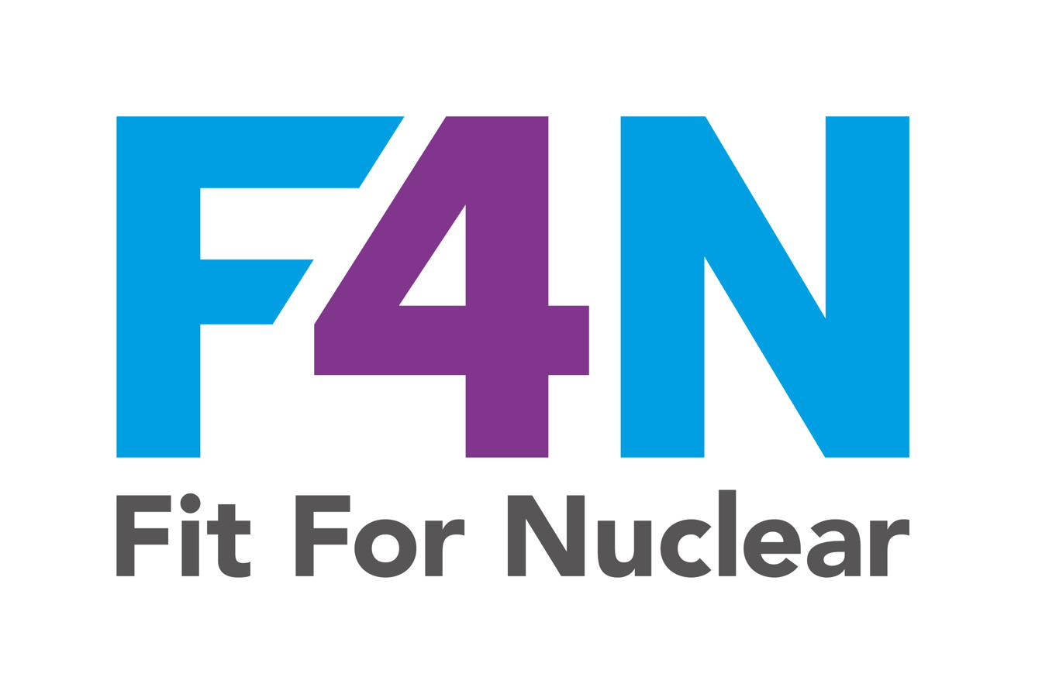
People Excellence
Building a high-performing, engaged, and nuclear-ready team
Commercial in Confidence
NucCol | Nuclear Collaboration Ltd · Fit For Nuclear Programme · Commercial in Confidence | 1

Slide 2
What is People Excellence?
People Excellence is the third section of the F4N Business Excellence assessment. It looks at how well your organisation develops, engages, and supports its people.
Employee Awareness
Employee Objectives
Employee Engagement
Employee Morale
Employee Development
Do employees understand the company's mission, vision, values, and their role in delivering them?
Does every employee have SMART objectives aligned to the company strategy?
Are employees actively involved in improvement and contributing to the business?
Is morale monitored? Are survey results acted upon?
Is there a structured appraisal and PDP process for every employee?
HR Records
Skills and SQEP
Ideas and Suggestions
Resource Planning
Health and Wellbeing
Are training records, qualifications, and SQEP status properly maintained?
Is there a skills matrix? Are gaps identified and addressed?
Is there a process to capture and act on employee ideas?
Does the business understand its future people needs?
Are employees' health and wellbeing actively supported?
NucCol | Nuclear Collaboration Ltd · Fit For Nuclear Programme · Commercial in Confidence | 2

Slide 3
Employee Awareness and Objectives
The assessor will ask employees directly about the company's mission, vision, and values. They will also check whether employees have objectives linked to the company strategy.
Employee awareness means:
SMART objectives mean:
Knowing the company's mission, vision, and values by heart
Understanding where the company is heading and why
Knowing how your specific job contributes to the overall goals
Being briefed regularly on company performance and priorities
Seeing strategy communicated visually: on notice boards, in briefings, on performance boards
Specific: clearly describes what needs to be achieved
Measurable: has a target you can track and verify
Achievable: realistic given your role and resources
Relevant: linked to a company strategic objective
Time-bound: has a clear deadline
Every employee must have documented objectives, reviewed at least annually through the appraisal process. The assessor will want to see examples. Use the Appraisal and PDP (PEOP-01).
NucCol | Nuclear Collaboration Ltd · Fit For Nuclear Programme · Commercial in Confidence | 3

Slide 4
The Appraisal and Personal Development Plan (PDP)
The appraisal is the foundation of the People Excellence framework. It links individual performance and development to the company's strategic goals.
1. BEFORE
2. APPRAISAL MEETING
3. PDP
4. MID-YEAR CHECK
5. NEXT APPRAISAL
Prepare: employee self-assesses. Manager reviews previous objectives and gathers evidence.
Review performance. Agree new objectives. Discuss career aspirations. Wellbeing check-in.
Agree development actions. Training needed. Target dates. How effectiveness will be measured.
Informal review halfway through the year. Are we on track? Any changes needed?
Review objectives against outcomes. Evidence of development. Repeat cycle.
GDPR reminder: Appraisal documents contain personal data. Store securely. Share only with the employee, their line manager, and HR. Redacted versions may be shown to F4N assessors.
NucCol | Nuclear Collaboration Ltd · Fit For Nuclear Programme · Commercial in Confidence | 4

Slide 5
Skills Matrix and SQEP: Knowing What You Have
SQEP stands for Suitably Qualified and Experienced Personnel. In the nuclear sector, it is a formal requirement that every person carrying out a quality-critical activity is demonstrably qualified and experienced to do so.
The Skills Matrix tells you:
SQEP requirements for nuclear work:
What skills each employee currently has
What level they are at (0=none to 4=expert)
Where mandatory skills are missing
Where there are skills gaps versus what the role requires
Where you have capability to do more nuclear work
Quality inspectors: CSWIP 3.1, PCN Level 2, or equivalent
Welders: BS EN ISO 9606-1 qualification per WPS
NDT inspectors: PCN Level 2 for applicable technique
Quality Manager: CQI membership, ISO 9001 Lead Auditor
H&S Manager: NEBOSH Certificate minimum
All staff: Nuclear safety culture awareness training
Nuclear customers will ask to see SQEP evidence at contract review and during quality audits. An expired qualification on a safety-critical role is a major non-conformance. Keep the SQEP register up to date and set alerts for renewals.
NucCol | Nuclear Collaboration Ltd · Fit For Nuclear Programme · Commercial in Confidence | 5

Slide 6
Training: It's Not Just About Attendance
F4N assessors specifically look for evidence that training has been effective, not just that it took place. Signing an attendance sheet is not enough.
How to assess whether training worked:
Written Test / Quiz
Before and after quiz scores. Average improvement shows learning has occurred. Keep records.
Practical Observation
Manager or supervisor observes the employee doing the task correctly after training. Record the observation.
Live Project Completed
For CI training: employee completes a live problem-solving project within 30 days. File the project record.
Manager Review at 30 Days
Line manager reviews whether behaviour has changed at the 1-month mark. Record the discussion.
Audit / Inspection Result
Post-training compliance checked at next internal audit. Improved score demonstrates effectiveness.
NucCol | Nuclear Collaboration Ltd · Fit For Nuclear Programme · Commercial in Confidence | 6

Slide 7
Employee Engagement: Beyond the Survey
Engagement is not measured by a survey alone. It is evidenced by what employees actually do: do they submit ideas? Do they participate in CI? Do they go beyond their job description?
Ideas Scheme
CI Participation
Toolbox Talks
A formal process to submit, review, and act on employee ideas. Respond within 5 working days. Share results. QHSE-CI-04 is your tool.
Employees involved in CI projects, 5S, Kaizen events, or problem-solving teams. Record participation.
Regular team briefings on safety, quality, CI, and company performance. Two-way: employees speak, not just listen.
Suggestion Board
Team Briefings
Safety Culture
Visual board on the shopfloor where ideas and updates are posted. Shows ideas submitted, decisions made, benefits achieved.
Regular structured briefings on company performance, priorities, and changes. Record attendance.
Near miss reporting rate is a key engagement indicator. High reporting = high engagement. Low reporting = concern.
NucCol | Nuclear Collaboration Ltd · Fit For Nuclear Programme · Commercial in Confidence | 7

Slide 8
The Employee Engagement Survey
Running a regular engagement survey and acting on the results is evidence of a mature People Excellence approach. The assessor will ask what you do with the results.
Running the survey:
Acting on the results:
Run at least annually. Ideally twice per year.
Anonymous: employees must feel safe to be honest.
Cover all 10 People Excellence themes.
Include open-text questions as well as rated questions.
Use PEOP-04 as your standard survey document.
Target response rate: >80% of employees.
1
Share results with ALL employees within 4 weeks
2
Identify the top 3 areas for improvement
3
Create a visible action plan with owners and dates
4
Update employees on progress against the action plan
5
Compare scores year-on-year to show improvement
Running a survey and not acting on it is worse than not running one. Employees who complete a survey and see nothing change become more disengaged. Always close the loop.
NucCol | Nuclear Collaboration Ltd · Fit For Nuclear Programme · Commercial in Confidence | 8

Slide 9
Resource Planning and Succession
The assessor will ask how you plan for your future people needs and what happens if a key person leaves. These are strategic questions, not just HR questions.
Resource planning means:
Succession planning means:
Knowing your current headcount vs what you need
Understanding future requirements linked to your strategy and CSIP
Identifying skills gaps before they become crises
Planning for growth in nuclear work (more SQEP needed)
Using PEOP-05 to track resource requirements and gaps
Identifying which roles are critical to the business
For each critical role: who could step in tomorrow if needed?
Developing people for future roles before the vacancy arises
Documenting knowledge so it doesn't walk out the door
Reviewing succession at least annually at management review
A company with no succession plan for its Quality Manager is carrying a significant risk. One resignation away from losing nuclear qualification capability. Use PEOP-05 to map and mitigate this.
NucCol | Nuclear Collaboration Ltd · Fit For Nuclear Programme · Commercial in Confidence | 9

Slide 10
Health and Wellbeing
F4N assessors expect to see that the company proactively supports employee health and wellbeing, not just reacts to problems. This links directly to safety culture.
Physical Health
Mental Health
Workload Management
Occupational health access. Regular DSE assessments. Ergonomics reviews. Manual handling training and equipment. Encouraging breaks and rest.
Mental health first aiders. Signposting to Employee Assistance Programme (EAP). Managers trained to have supportive conversations. Reduced stigma.
Monitoring workload and overtime. Ensuring people are not consistently working unsustainable hours. Raising concerns before burnout.
Inclusion and Respect
Wellbeing Check-ins
Recognising Contribution
A workplace where everyone is treated with dignity and respect. Clear harassment and bullying policy. Diverse and inclusive culture.
Formal wellbeing question in every appraisal. Line managers regularly checking in with team members. Not just asking once a year.
Saying thank you. Recognising people who contribute ideas, go the extra mile, or achieve a qualification. Recognition does not need to be expensive.
NucCol | Nuclear Collaboration Ltd · Fit For Nuclear Programme · Commercial in Confidence | 10

Slide 11
Your People Excellence Toolkit
These documents cover every element of the F4N People Excellence assessment.
PEOP-01
Employee Appraisal and Personal Development Plan
Structured appraisal covering objectives, PDP, career development, wellbeing, and sign-off. Use for every employee annually.
PEOP-02
Skills Matrix and Competency Framework
Visual skills matrix, SQEP register, competency framework, and capability gap analysis.
PEOP-03
Training Record and HR Register
Training log, mandatory training matrix, effectiveness assessment, and induction checklist.
PEOP-04
Employee Engagement Survey
34-question anonymous survey covering all 10 People Excellence themes. Run at least annually.
PEOP-05
Resource Planning and Succession Plan
Workforce resource plan, succession plan for critical roles, and people dashboard.
QHSE-CI-04
Ideas and Suggestions Log
NucCol | Nuclear Collaboration Ltd · Fit For Nuclear Programme · Commercial in Confidence | 11

Slide 12
People Excellence
Three things every line manager should do this month:
1. Check every team member has current objectives linked to the company strategy. 2. Make sure every team member has a completed training record and no expired SQEP qualifications. 3. Have a genuine wellbeing conversation with each team member.
Questions? Speak to HR or the senior leadership team.
Commercial in Confidence | [Company Name] | [Date]
NucCol | Nuclear Collaboration Ltd · Fit For Nuclear Programme · Commercial in Confidence | 12

